Slide 1
CSC371-Database Systems I Lecture-9 (Lab) (Fall2023)

Slide 2
Previous Lecture Review
SQL Update
SQL Delete
SQL Select Top
SQL ORDER BY
SQL Aliases
SQL MIN() and MAX() Functions
SQL COUNT(), AVG() and SUM() Functions

Slide 3
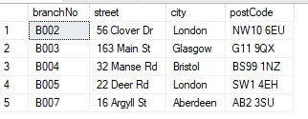
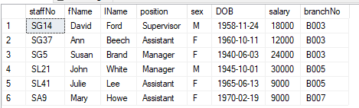
Branch
Staff

Slide 4
Agenda
SQL Group By Clause
SQL Having Clause
SQL Views

Slide 5
GROUP BY Syntax
Groups rows that have the same values into summary rows
Find the number of staff members in each branch
It is often used with aggregate functions to group the result-set by one or more columns.
Used COUNT, MAX, MIN, SUM, AVG functions.
SELECT column_name(s) FROM table_name WHERE condition GROUP BY column_name(s) ORDER BY column_name(s);

Slide 6
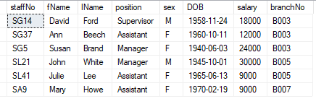
Show branch wise data from staff table?
Select * from staff group by branchno
Select * from staff order by branchno

Slide 7
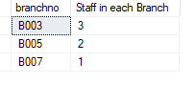
Use of Group by with Count function
Count how many employees in each branch?
SELECT branchno, COUNT(staffno) AS [Staff in each Branch]
FROM staff
GROUP BY branchno;

Slide 8

Group By with ORDER BY Clause
SELECT branchno, COUNT(staffno) AS [Staff in each Branch]
FROM staff
GROUP BY branchno
ORDER BY COUNT(staffno) ASC;
SELECT branchno, COUNT(staffno) AS [Staff in each Branch]
FROM staff
GROUP BY branchno
ORDER BY branchno DESC;

Slide 9

Can you find out the average salary of Assistants in each branch?
SELECT branchno, Avg(salary) AS [Average salary of Assistants in each Branch]
FROM staff
Where position = 'assistant'
GROUP BY branchno
ORDER BY branchno DESC;

Slide 10
Can you generate a report for branches where more than two employees are working?
select branchNo, count(staffno) As [Total Employee]
From staff
where count(staffno) > 2
Group by branchno

Slide 11
The SQL HAVING Clause
The HAVING clause was added to SQL because the WHERE keyword could not be used with aggregate functions.
Applied condition on group data
SELECT column_name(s) FROM table_name WHERE condition GROUP BY column_name(s) HAVING condition ORDER BY column_name(s);

Slide 12

Can we find out the branch number with more than two employees
select branchNo, count(staffno) As [Total Employee]
From staff
Group by branchno;
Having count(staffno) > 2

Slide 13
select branchNo, count(staffno) As [Total Employee], Avg(salary) AS [Average Salary]
From staff
Where salary >= 9000
Group by branchno
Having count(staffno) > 1
Order By count(staffno) DESC;

Slide 14

select branchNo, count(staffno) As [Total Employee], Avg(salary) AS [Average Salary]
From staff
Where salary > 10000
Group by branchno
Having count(staffno) > 1;
Is the Result correct?
If yes How?
If Not Why?

Slide 15
SQL CREATE VIEW Statement
Virtual table based on the result-set of an SQL statement.
The fields in a view are fields from one or more base/real tables in the database.
Can add SQL functions, WHERE, JOIN statements and sub-query.
Fetch data from many tables to a view and present the data as if the data were coming from one single table.
Security Purpose
Reporting Services

Slide 16

SQL CREATE VIEW
CREATE VIEW view_name AS SELECT column1, column2, ... FROM table_name WHERE condition;
CREATE VIEW [Branch_B003] AS SELECT staffno, fname, salary FROM staff WHERE branchno = ‘B003’’;
select * from branch_B003

Slide 17

SQL CREATE OR REPLACE VIEW
CREATE OR ALTER VIEW [Branch_B003] AS SELECT staffno, fname, lname,salary FROM staff WHERE branchno = ‘B003’’;
select * from branch_B003

Slide 18
Drop View
DROP VIEW [branch_b003];

Slide 19
Summary
SQL Group By Clause
SQL Having Clause
SQL Views

